Slide 1
Weather and Bike Rentals
What are the influening factors and
how we l can they predict the number of rented bikes?
Ingo Nader Nov 2018

Slide 2
Abstract
This piece of work investigates to what extent and how weather and time of day influence bike rentals in a public bike sharing system in Montreal. Public data obtained from the Canadian government’s past weather and climate service, as well as bike sharing data available from Kaggle are analyzed via a simple baseline model (moving average) and a more complex machine learning model (gradient boosting regression). Partial dependence plots (PDP) and individual conditional expectation plots (ICE) are used to visualize the influences of the different factors.
Results show that the model can explain the number of hourly bike rides very well (93.3% of variance explained). The most important influences on the number of bike rides seem to be temperature, atmospheric pressure, hour of the day and relative humidity, but there are strong interactions between these influences: For example, the number of predicted bike rides increases with temperature, but only if relative humidity is not too high.
The full analysis is available in multiple python files on github: kgl­cycle­share­main­file.py.
A synopsis is available as an ipython notebook cycle­share­analysis­synopsis.ipynb, or as html to download.

Slide 3
Motivation
There are quite a few analyses that investigate bike sharing in relation to weather, and also some freely available and easily retrievable datasets. But they often use daily aggregates (e.g., the UCI machine learning dataset on bike sharing), or they only have a relatively small sample size (e.g., Kaggle bike sharing demand). As I use my bike on a daily basis for (parts of) my commute, I found these investigations very interesting. However, I always thought that daily aggregate data is not enough to understand the phenomenon. Personally, I don’t decide on the weather of the whole day if I’ll be using the bike. Rather, I just decide if I can use the bike right now.
Hence, I wanted to do a similar analysis myself, but on a more fine­grained level, i.e., on hourly data, with a big enough sample size to try out some machine learning models.

Slide 4
Dataset(s)
Two datasets were used: Bike sharing data…
BIXI Montreal public bicycle sharing system, North America’s first large­scale bike sharing system
Available via Kaggle from https://www.kaggle.com/aubertsigouin/biximtl/home
For years 2014 to 2017
Contains individual records of bike trips: timestamp and station code for start and end of trip, duration
n = 14598961 records (individual bike trips)
Station codes, names, and position (latitude, longitude) available in separate files, but only of secondary interest for this analysis
…and weather data from the Canadian government:
Canadian government’s past weather and climate service, available from http://climate.weather.gc.ca/ historical_data/ search_historic_data_e.html
API for bulk data download: http://climate.weather.gc.ca/climate_data/ bulk_data_e.html
Data can be downloaded per weather station per month and contains hourly measurements of different metrics (e.g., timestamp, temperature, relative humidity, atmospheric pressure, wind speed; different measures available for different stations)
n = 35064 hourly weather records in total (between 672 and 744 per monthly file)

Slide 5
Data Preparation and Cleaning
First, data download was performed manually for the bike share data from Kaggle (as only available after login), and via a Python script for the weather data (bulk download).
For the weather data, the weather station that was most central to the locations of the bike rides was picked (see data exploration).
Next, the data was loaded and contatenated into a pandas DataFrame each for individual bike rides and hourly weather data.
The next step was calculating the variable of interest: Hourly bike rides. This was done by aggregating individual bike trips to hourly counts of trips (number of trips in each hour), using the starting time of the trip.
Then, the weather data was joined to the hourly bike ride data, using the common timestamp as join key.
One feature (wind chill) was dropped, as it had too many missing values (77.9% missing).
Finally, additional features were added for the analysis: hour of the day (0­23), day of the week ( 0­6, zero corresponding to Monday, six corresponding to Sunday), month (1­12).
despite being categorical in nature, were kept as continuous features, as this proved to have more predictive power in the models.
For modeling, rows with missing values were dropped, as the goal is not having the most complete prediction coverage, but rather an indication of the prediction quality that is possible with complete data. In total, 1284 rows (0.04%) of the original data were dropped.
The remaining rows were split into training and testing set (90% of the data, n = 26168 rows for training, the remaining 10%, n = 2908 for testing).
These features,

Slide 6
Research Question(s)
The research questions that I wanted to answer with my analysis were:
To what extent do the number of bike rides depend on the current weather conditions? That is, how well can the number of bike rides be predicted from weather data (and time of year, time of day)?
What are the most important factors that influence the number of bike rides?
How do these factors influence the number of bike rides? What are the main effects of these factors, and what are the interactions between them?

Slide 7
Methods
First, some data exploration was performed, in order to get to know the data and to find out how the number of hourly bike trips is distributed across the investigated time span. Also, the interrelation of features was investigated by means of a correlation heatmap.
In order to find out how well the number of bike rides can be predicted from the data, different models were used. As a baseline model, a moving average was calculated to find out how this very simple model can explain the data.
Then, after splitting the data into 90% training and 10% test set, different machine learning models were fitted to the data in order to predict the hourly number of bike rides from the available data: Random forest regression, and gradient boosting regression via scikit-learn and xgboost . The most promising model, scikit-learn ’s gradient boosting regression, was fitted via a randomized 4­fold cross­validation for indentifying the best hyperparameters. Variable importance was used to identify the most important influence factors, and partial dependence plots (PDP) [1] and individual conditional expectation (ICE) plots [2] were used to visualize the influences of the important variables on the number of bike trips.

Slide 8
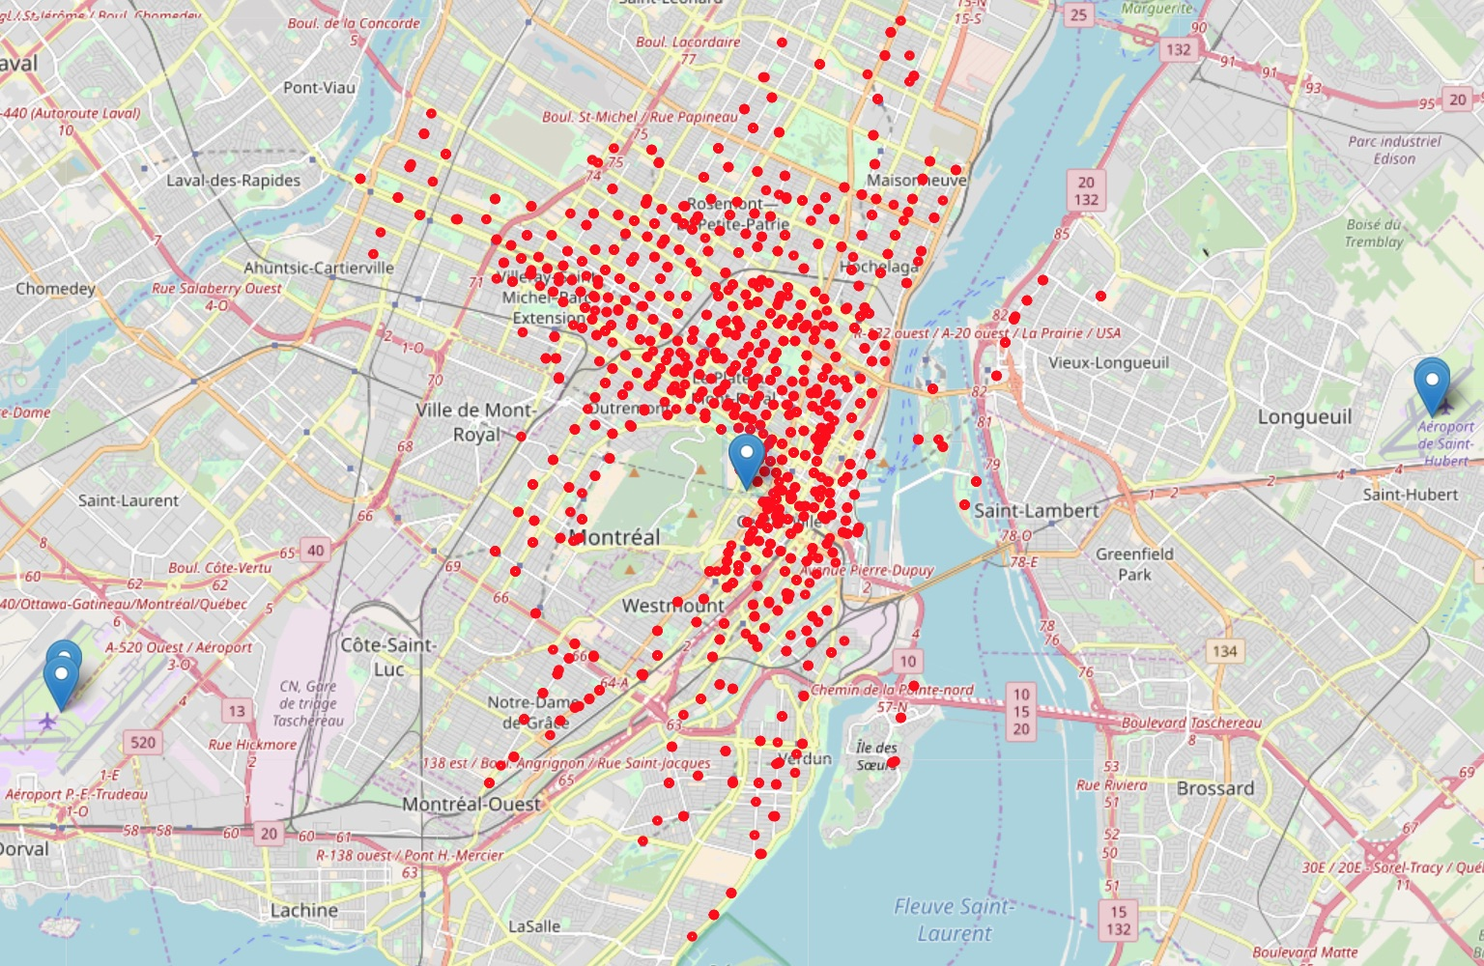
Findings: Data Exploration
The Canadian government’s past weather and climate service provides data from weather
stations around the whole country. Fortunately, it offers a search by proximity function. Via this service, some sample data of the closest stations to Montreal were downloaded. Each of the data files contains information about the weather stations, including the geographical position (latitude and longitude). These coordinates were plotted on a map (see Figure on the right), and the closest station to the bulk of the data was chosen (station name: MCTAVISH). Only data from this station was used.
Figure: Plot shows all starting stations of a bike trip (red dots), as well as the closest weather stations (blue markers). The closest station in the center is the MCTAVISH weather station (Climate Identifier 7024745, WMO Identifier 71612)

Slide 9
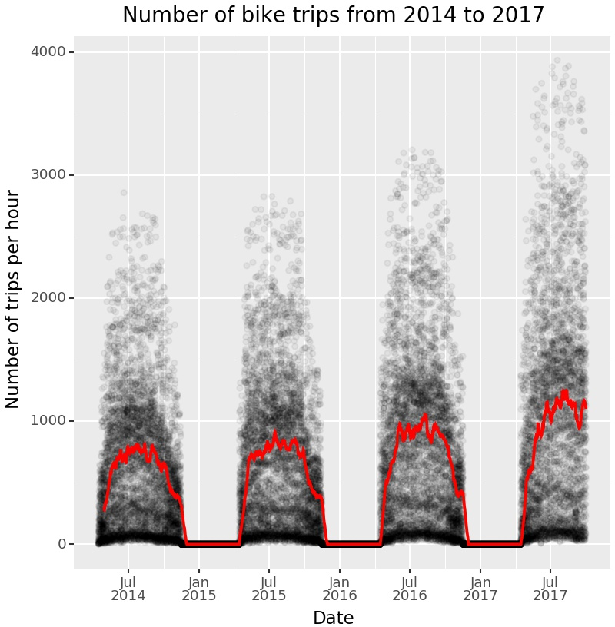
Findings: Data Exploration
To get a better understanding of the data, the number of hourly bike trips was visualized for the time span between 2014 and 2017.
The moving average that is shown in the plot (red line) can be interpreted as a baseline model, i.e., the simplest possible model to describe the hourly number of bike rides.
This baseline model explains 38.8% of the variance
(r² = 0.388)
and has a mean absolute error of
MAE = 316.2 , which means that on average, the prediction for the number of hourly bike rides is wrong by this many bike rides. This includes also winter months with no rides. For a more realistic estimation of model quality, these numbers drop to
Figure: Number of hourly rides from 2014 to 2017. Each dot represents the number of trips in one specifc hour. Red line represents a moving average using a window of 14 days.
r² = .079
and MAE = 510.7 when only considering
the time frame from May to September.

Slide 10
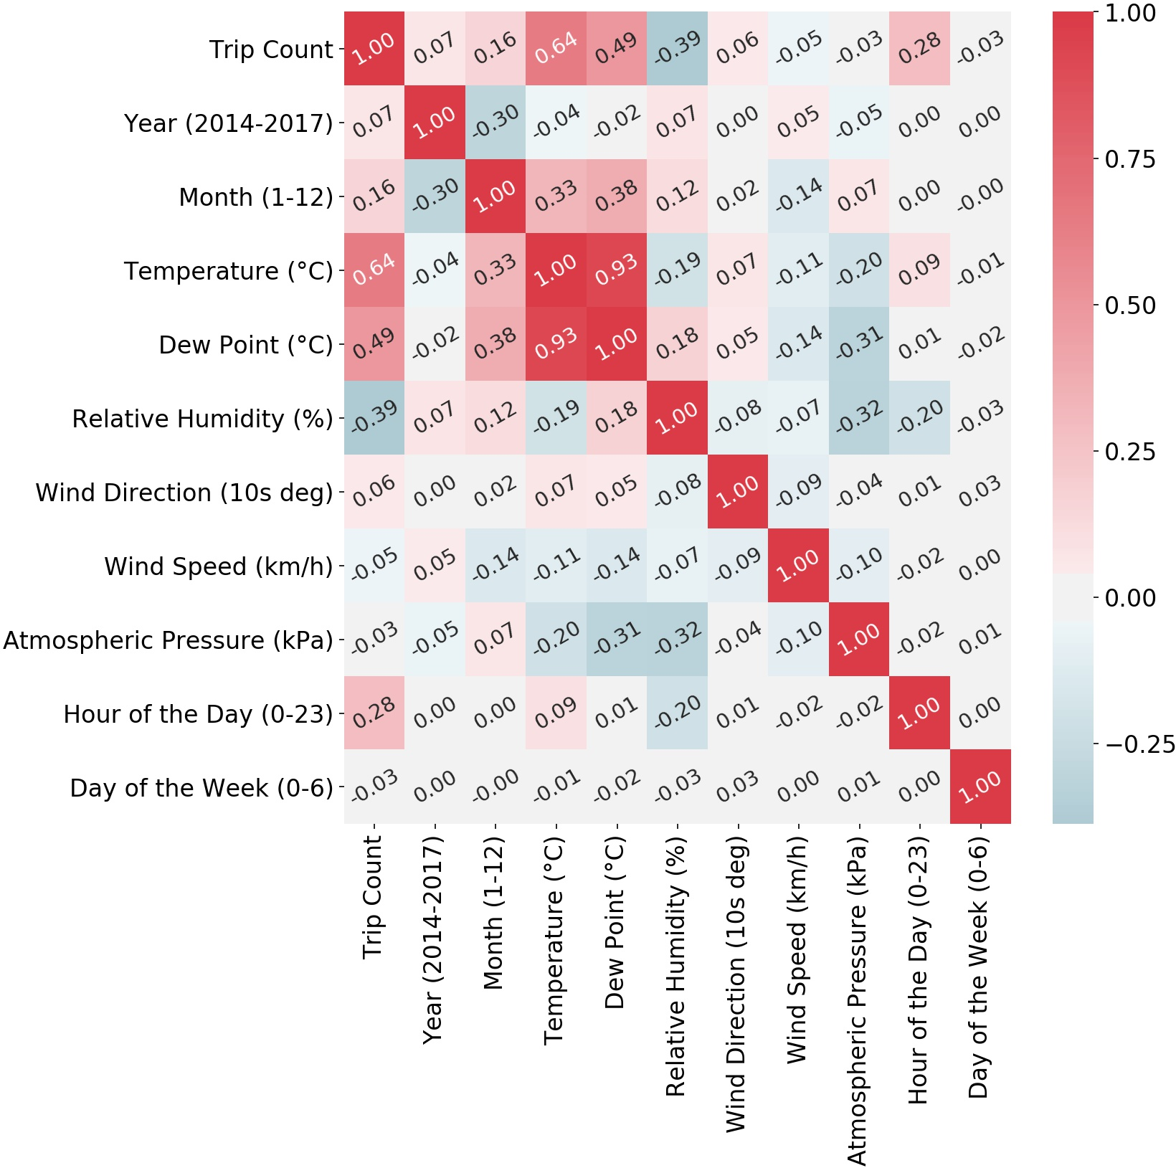
Findings: Data Exploration
To visualize the relations between the available features, a correlation heatmap is shown on the right. The features are only slightly correlated, with the only exception being temperature and dew point that show an almost perfect (linear) relationship (r = .93).
To avoid problems resulting from this multicollinearity, only temperature was used as a predictor, and dew point was dropped. Despite the fact that that gradient boosting is less influenced by multicollinearity, it might still influence calculations of variable importance [3,4].
Figure: Pearson Correlations between available features in the data.

Slide 11
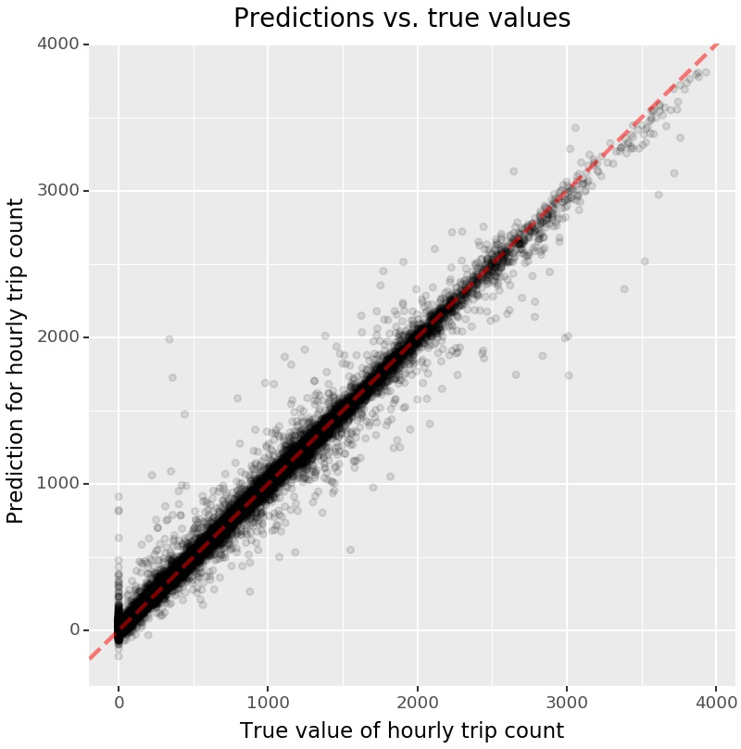
Findings: Model Fit
The explained variance of the different models tried
ranged from r² = 0.865 to r² = 0.941 for the final
test test
model (all in the test set; see
table). The
hyperparameters
for the
final
model
(gradient
boosting via scikit­learn) were selected via randomized search using 4­fold cross validation (using only the training set).
The final model fits the data very well, explaining 94.1% of the variance and exhibiting an average error of 85.4 rides over all hourly predictions. This error increases only slightly (to 105.4) when only summer months are considered.
Table: Model performance measures for different models. r² is the amount of variance explained, MAE stands for mean absolute error. train and test specify training and testing set, respectively. For the test set, some performance measures were also re­computed for using only the summer months of the test set (May to September), indicated via the summer subscripts.
train test summer test summer
Figure: The figure shows actual (true) values vs. predicted values for the number of hourly bike trips for the final model. A perfect model would yield predictions that are identical to the true values, i.e., all points would be on the 45° diagonal. This model is relatively close.
Model | _{r}2 | _{r}2 | r² MAE | MAE
Gradient Boosting (XGBoost) | 0.896 | 0.865 | 0.856 155.3 | 173.1
Random Forest | 0.913 | 0.894 | 0.880 111.2 | 139.9
Gradient Boosting (sklearn) | 0.997 | 0.941 | 0.933 85.4 | 105.4

Slide 12
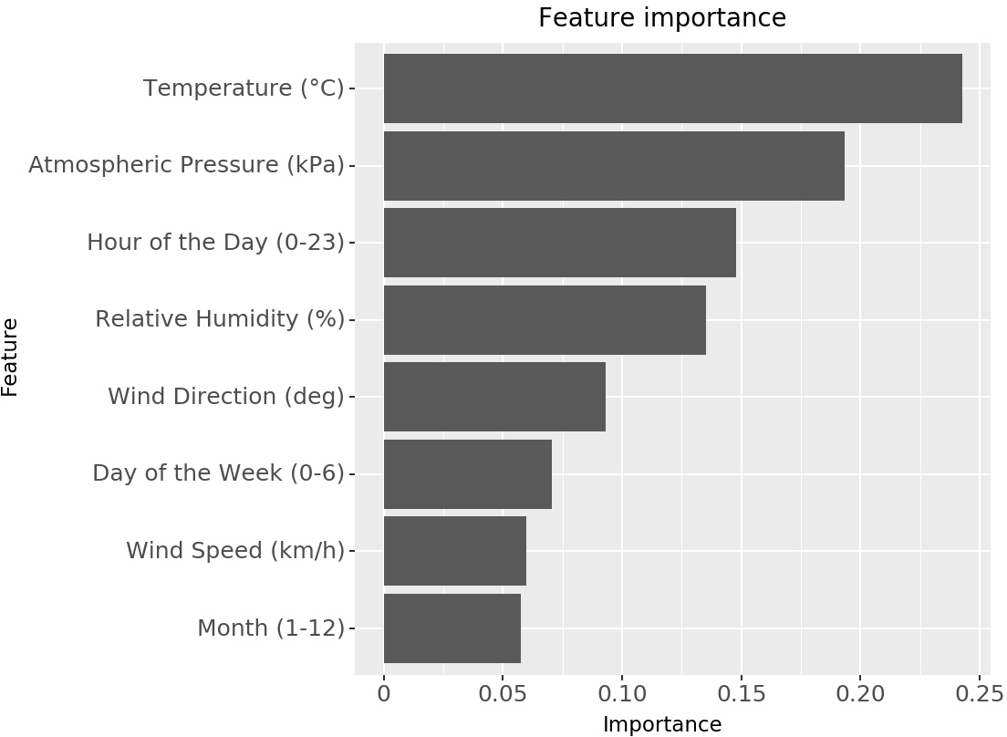
Findings: Most Important Features
The most important features that influence the prediciton of hourly bike rides were temperature and atmospheric pressure. While the former is easily comprehensible, the latter is probably best understood as a proxy for precipitation, which was not available from the weather data: low pressure is commonly related to rainy weather [5]. While relative humidity is not as tightly connected to rain [6], it interacts with temperature, e.g., it influences how (high) temperatures are perceived [7].
Further important predictors are the hour of the day and the day of the week, as well as wind direction and speed. How these features influence the predicted number of bike trips is best detailed by specific plots, so­called partial dependence plots (PDP) [1] and individual conditional expectation (ICE) plots [2].
Figure: Most important features in the best­fitting model (gradient boosting via scikit­learn). The plot shows the most important features and their relative importance for predicting the hourly number of bike trips. The importance value indicates how well a feature performs in order to reduce the mean squared error for predicting the outcome, averaged over all trees in the ensemble. Values are normed and cannot be interpreted on an absolute scale [ 8].

Slide 13
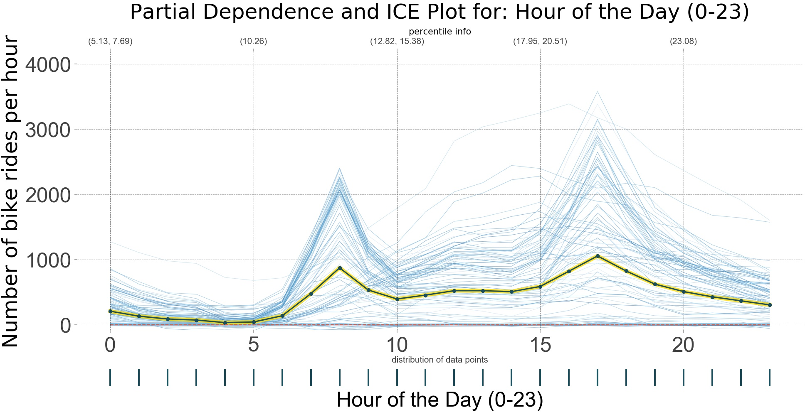
Findings: Main ef ects
Regarding hour of the day, rush hours are clearly associated with higher number of hourly bike rides. There is a peak at eight o’clock in the morning and a (less pronounced) one in the afternoon. It is also visible that hour of the day interacts with other variables. First, the average PDP line is misleading, as there is a dense area of parallel lines indicating higher bike rides, as well as a high density at zero bike rides (i.e., the average PDP line obscures these two clusters). Second, There are a few lines showing a different pattern, starting to pick up only after the rush hour and steadily rising until the afternoon. This might be the interaction with the day of the week (see section Interactions; see also figure caption for more details about PDP and ICE plots).
Figure: Partial dependence plots (PDP) [1 ,2] show the influence of a feature over its whole range (x­axis). The predicted outcome is visualized on the y­axis. That is, the thick, dark blue line in the plot shows the main effect of a feature. In addition, individual conditional expectation (ICE) plots [2 ] quantify the extent of interactions that exist with other variables. The fine, light blue lines in the plot show predictions at different levels of the feature in question. If they these lines are parallel, there are no interactions with other features. If they are not and show varying slopes compared to the main affect, the feature interacts with other features.
In addition, the plot shows the distribution of the data over the whole feature range as dark blue ticks below the y­axis. For hour of the day, this is not very interesting (only full hours), but it shows areas with sparse data for other features.

Slide 14
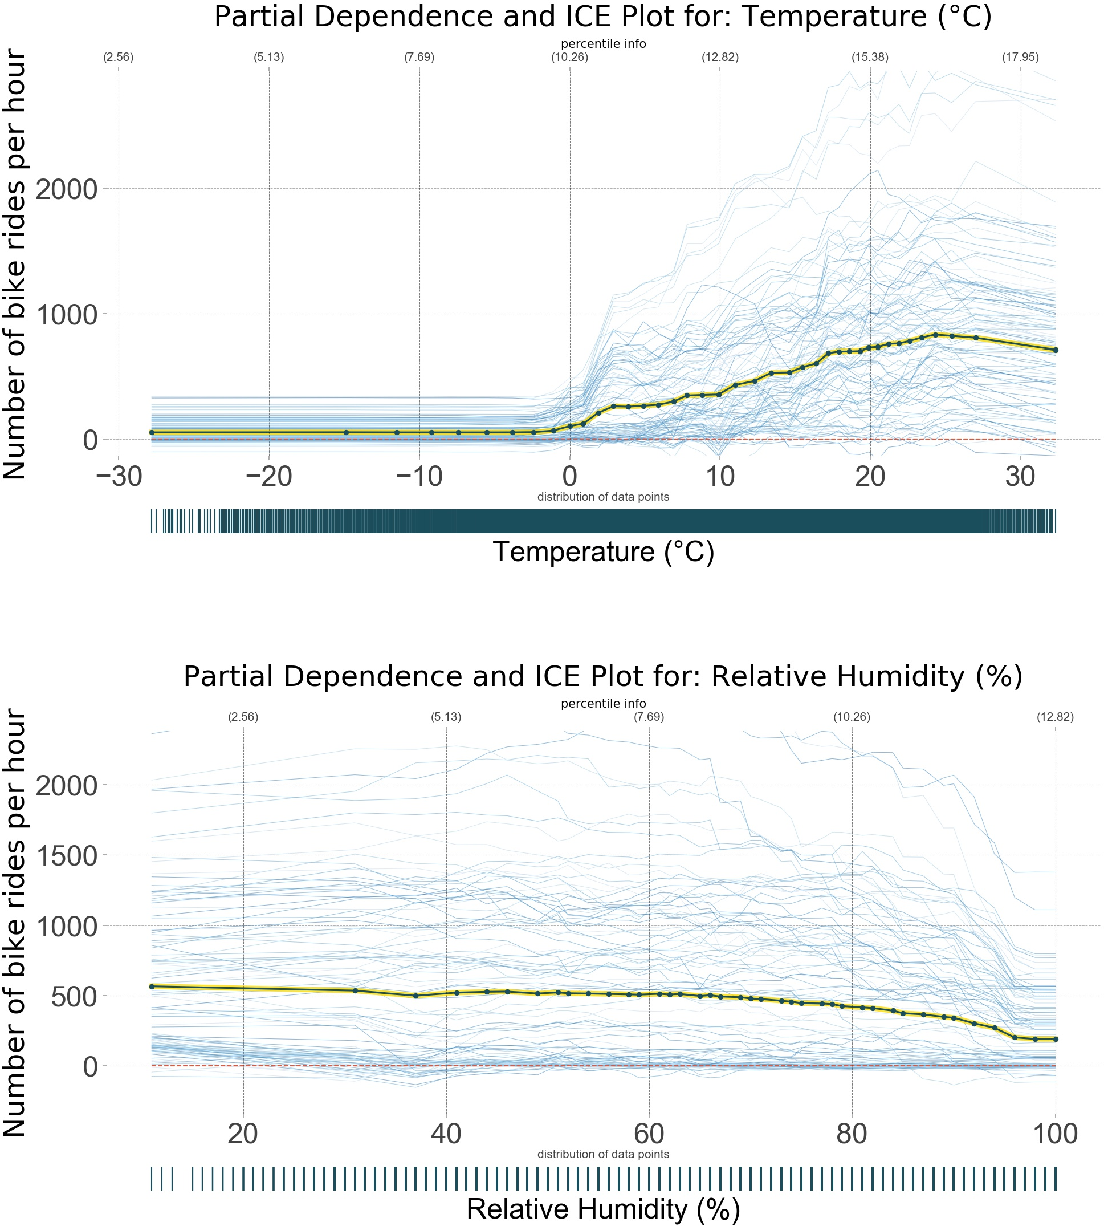
Findings: Main ef ects
Bike rides also increase with the temperature (the most important feature), once it has reached a certain treshold of about two or three degrees celcius. The increase is relatively steady up to a temperature or about 25 degrees celcius, where the number of hourly rides starts to level off and then to slightly decline. It is also visible (from the spread of the ICE plot lines) that there are massive interactions of temperature with other features.
For relative humidity, the main effect is less
pronounced. The general tendency is a
slight more
decrease for higher humidity, with a
pronounced drop around 95%. But the main effect is relatively weak compared to the overall spread of the ICE plot lines, and there are strong interactions with other features for higher relative humidity.
Figure: Partial dependence plots (PDP; thick, dark blue lines) [ 1] and individual conditional expectation (ICE) plots [ 2] (thin, light blue lines). For a more detailed explanation, see first occurence of this plot type on the previous page.

Slide 15
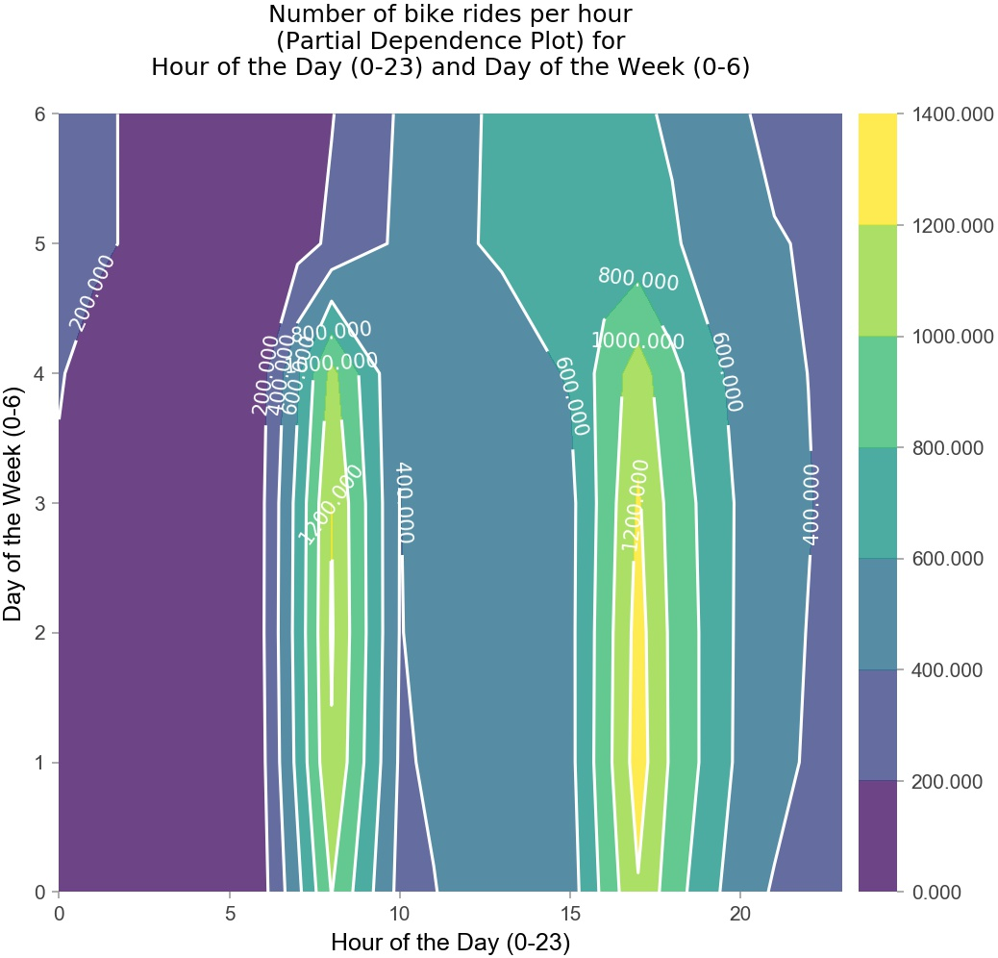
Findings: Interactions
The interaction between day of the week and hour of the day is not the strongest interaction in this model (see note on the side), but it serves well to describe the two­feature partial dependence plots (for details, see figure caption). It is clearly visible that during week days (0­4), there are peaks in the number of predicted hourly bike rides at 8 o’clock in the morning, as well as an even more pronounced peak in the afternoon (higher predicted numbers, as well as a broader peak). The number or predicted bike rides is slightly lower on Monday mornings.
During the weekend (days 5 and 6), the distribution is different (i.e., there is an interaction between the two features). There are by far fewer predicted bike rides, also the peak is in the afternoon. Additionally, there are more bike rides during the night, as compared to weekdays.
Figure: Partial dependence plots (PDPs) [1 ,2] for two­way interactions. These plots show the the effect of two variables on the predicted outcome (number of predicted hourly bike rides, coded as the color in the plot). The two features, in this case, are the day of the week and hour of the day. These plots do not show further, higher­order interactions with other features.
Note: The strength of two­way interactions was determined by estimating a gradient boosting regression model similar to the model described before, but with using main effects and two­way interactions as distinct features and then calculating the variable importance.

Slide 16
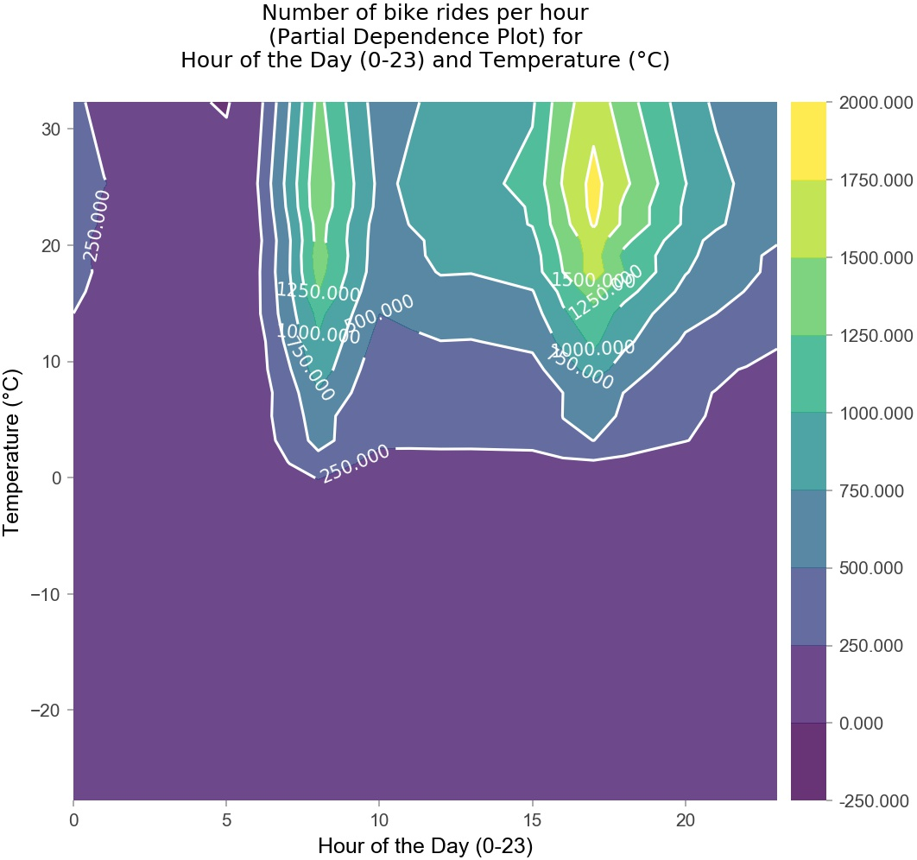
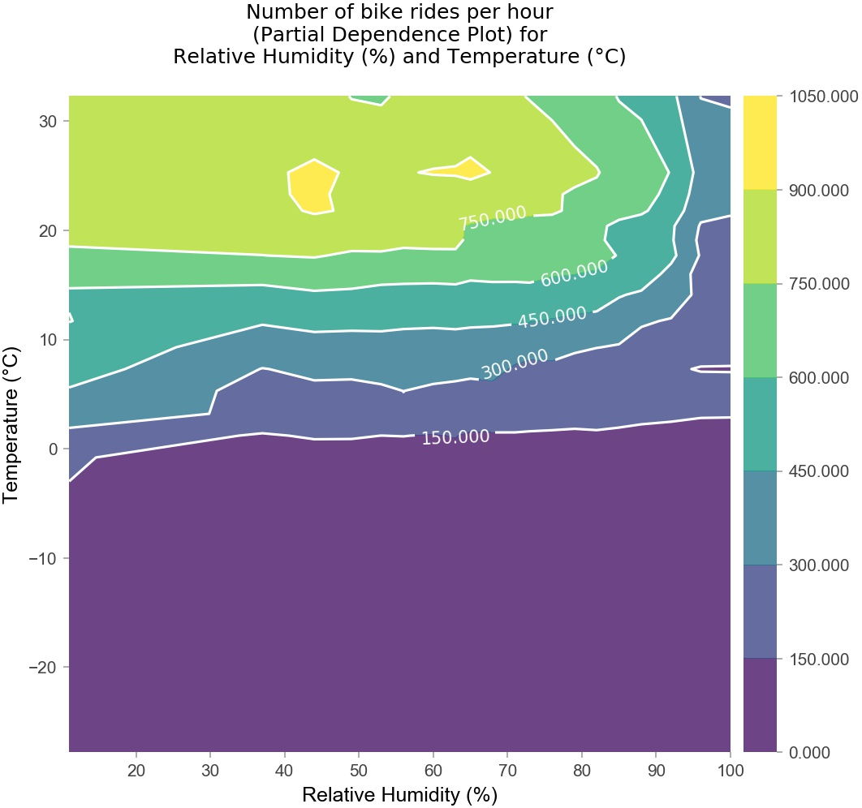
Findings: Interactions
Figure: Partial dependence plots (PDPs) [1,2] for two features. The number of predicted hourly bike rides is coded as the color in the plot. For a more detailed explanation, see first occurence of this plot type on the previous page.
The interaction between temperature and hour of the day is the strongest two­way interaction. The plot shows that the main effect (peaks at rush hour) is only valid for temperatures above approx. 0°C. This also applies for the interaction between temperature and relative humidity: The number of predicted bike rides drops with increasing relative humidity only for temperatures above 0°C. For lower temperatures, there are hardly any rides at all.

Slide 17
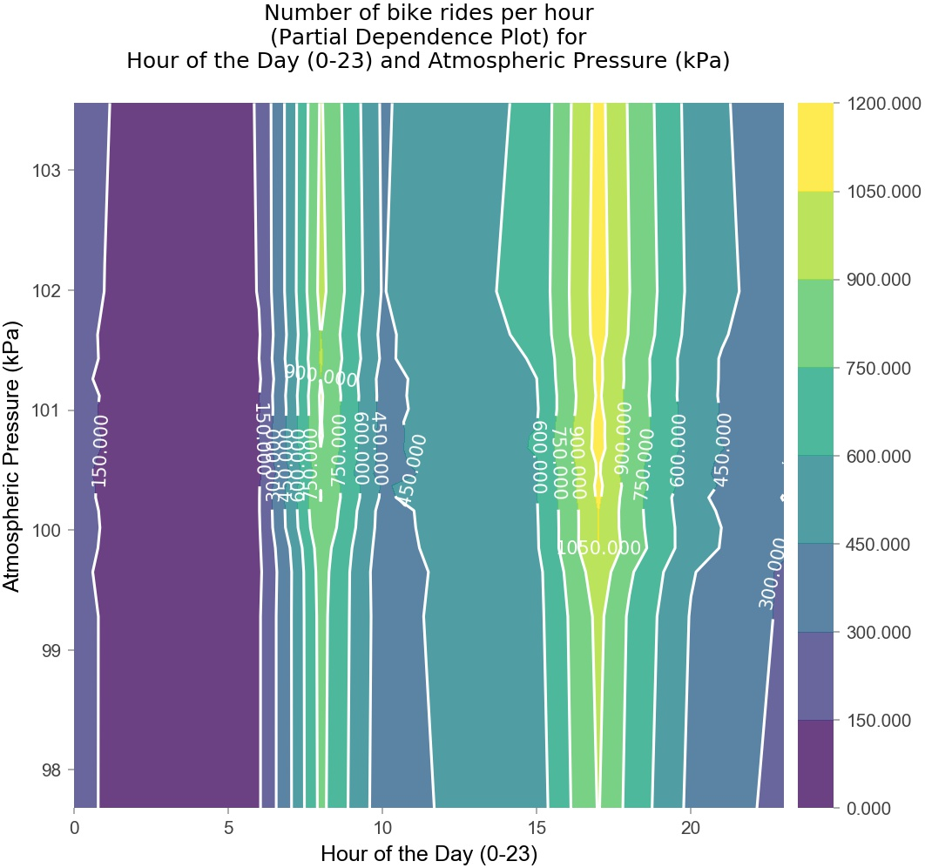
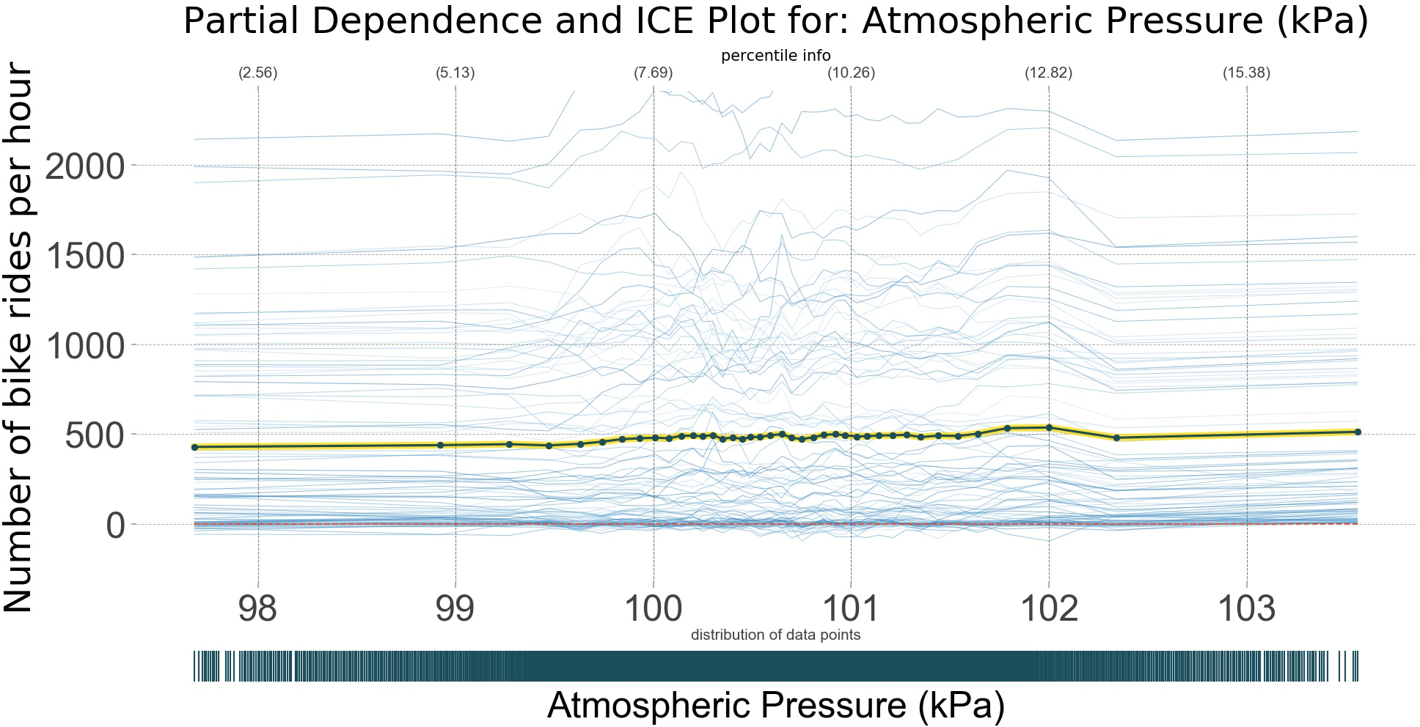
Findings: Interactions
Atmospheric pressure has almost no visible main effect (see figure on the bottom), but it turned out to be the second­most important interaction (with hour of the day). This interaction is depicted in the figure on the right: In the morning, number of bike rides increase when atmospheric pressure is above about 100 kP a, but in the afternoon, the increase in bike rides seems to happen at a slightly lower atmospheric pressure.
Figure: Partial dependence plot (PDP) shows no obvious main effect of atmospheric pressure on numer of bike rides.
Figure: Partial dependence plots (PDPs) [1 ,2] for atmospheric pressure and hourh of the day. The number of predicted hourly bike rides is coded as the color in the plot. For a more detailed explanation, see first occurence of this plot type on one of the previous pages.

Slide 18
Limitations
There are a few methodological issues that might merrit discussion. First, the gradient boosting model might have slightly overfitted the training data, but still the results in the test that were quite okay. Also, the decision to treat day of the week and time of day as continuous variables (and not categorical) might be worth revisiting (even given that the predictive power was better this way).
Regarding the data used, it might have been beneficial to use precipitation (rain, snow) as additional predictor. Unfortunately, this feature was not available for the given weather station. Moreover, it might also be worth using not actual weather, but weather predictions as additional features. However, this was beyond the scope of this project.
The results identified in this analysis might also be applicable for other cities, but only as long as the climate is somewhat comparable. Probably the biggest limitation of this analysis is that it only considers influences within the bike sharing system (i.e., how many of the available bikes are rented). It does not consider outside influences like traffic, availability of other means of transport, or the need for additional bike renting stations. This sets rather narrow boundaries on the usefulness of these results, unfortunately.

Slide 19
Conclusions
The number of bike rides seems to depend heavily on weather and time variables. It is possible to explain most of the variation and to make somewhat accurate predictions with a machine learning model.
The most important factors are relatively obvious ones. The number of bike rides increases with temperature (picking up at about 2­3°C, up to about 25°C). Atmospheric pressure does not have a strong effect on its own, but interacts heavily with other factors.. For relative humidity, the number of bike rides drops with increasing humidity. Hour of the day might be the most obvious factor, with most bike rides in the morning and in the afternoon.
For all of the variables, there are strong interactions. For example, bike rides only have morning and afternoon peaks during work days, not at weekends, and high relative humidity leads to fewer bike rides in general, but more so for higher temperatures.
In summary, the analysis confirmed obvious assumptions. Probably the biggest surprise was how well the model was able to predict the number of bike rides.

Slide 20
References
Molnar C. Partial Dependence Plot (PDP) [Internet]. 2018. Available: https://christophm.github.io/interpretable­ml­book/pdp.html
Goldstein A, Kapelner A, Bleich J, Pitkin E. Peeking Inside the Black Box: Visualizing Statistical Learning with Plots of Individual Conditional Expectation [Internet]. 2014. Available: https://arxiv.org/pdf/1309.6392.pdf
Wheatley J. Random forest or gradient boosting? [Internet]. 2014. Available: http://joewheatley.net/random­forest­or­gradient­boosting/
Parr T, Turgutlu K, Csiszar C, Howard J. Beware Default Random Forest Importances [Internet]. 2018. Available: http://explained.ai/rf­ importance/index.html
Morgan L. Why Does it Rain When the Pressure Is Low? [Internet].
https://sciencing.com/rain­pressure­low­
Haby J. RELATIVE HUMIDITY PITFALLS [Internet]. Available: http://www.theweatherprediction.com/habyhints2/564/
Dotson JD. How Temperature & Humidity are Related [Internet]. 2018. Available: https://sciencing.com/temperature­ampamp­ humidity­related­7245642.html
Drury M. Cross Validated: Relative variable importance for Boosting [Internet]. 2017. Available: https://stats.stackexchange.com/questions/162162/relative­variable­ importance­for­boosting
2017. Available:
8738476.html

